Slide 1
A Maximum Entropy Model for Text Classification
Nguyen Viet Cuong
Nguyen Thi Thuy Linh
Ha Quang Thuy
Phan Xuan Hieu Speaker:葉昱廷

Slide 2
ABSTRACT
This paper presents a machine learning model for Vietnamese text/web content classification and filtering that is based on the maximum entropy principle
The difficulty in identifying word boundaries of Vietnamese (isolated language) is solved by Maximum Matching approach based on a Vietnamese lexicon (LacViet MTD)

Slide 3
Vietnamese Example
Vietnamese is an isolated language and whitespaces are not always used to identify the word boundaries
How are you doing?
Dạo này chị thế nào ?
How # are # you # doing？
Dạo # này chị # thế nào ？

Slide 4
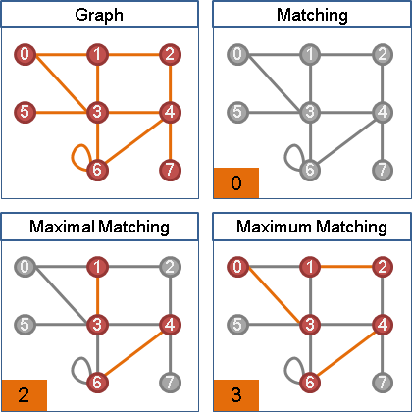
Maximum Matching
Cardinality
Maximal matching： 沒有辦法直接增加配對數的匹配。
Maximum matching： 配對數最多的匹配。
Perfect matching： 所有點都配對到的匹配。

Slide 5
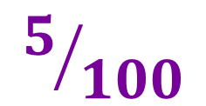
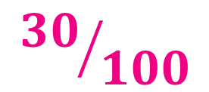
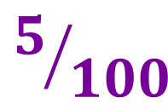




Maximum Entropy
$$5/{100}$$
Main idea
駕駛
$$5/{100}$$
$${30}/{100}$$
門簾
Unknown model generating the sample data should be the model that is most uniform and satisfy all constrains from sample data (or training data)
搭機
Fly
蒼蠅
懸掛
$${20}/{100}$$
$$5/{100}$$
飛行
飛奔
$$5/{100}$$
$${30}/{100}$$

Slide 6
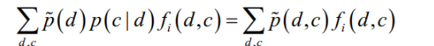
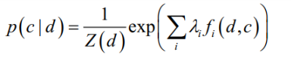
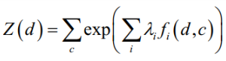
Maximum Entropy
Constrain Equation
D = {(d1,c1), (d2,c2),…, (dN,cN)} di is list of context predicate
ci is class corresponding to di
Exponential Form
Normalization Factor

Slide 7
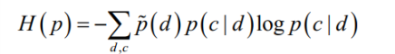
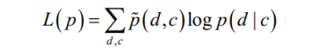
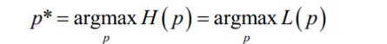
Maximum Entropy
Entropy
Exponential form guarantees
that the likelihood surface is convex
Likelihood
The same solution

Slide 8
N-Gram
N-gram of syllables
According to syllable , may contain meaningless words.
祝芃彣生日快樂
祝芃#芃彣 # 彣生 # 生日 # 日快 # 快樂

Slide 9
N-Gram
N-gram of words
According to segmentation , combination of meaningful words
祝芃彣生日快樂
祝芃彣#芃彣生日# 生日快樂
祝#芃彣 # 生日 # 快樂

Slide 10
Text Classification with ME
SECTION 03

Slide 11
Experimental Setup
1
2
3
4
English & Vietnamese
Vietnamese
Vietnamese
English
N-gram
of word
N-gram
of syllables
N-gram
of word
Independent language classifier
“10-fold cross validation test”

Slide 12
Training data
Vietnamese
6,400 Vietnamese news pieces in 8 classes, so each class has 800 news pieces.
Vietnamese lexicon (LacViet MTD) with more than 70,000 entries
English
6,207 English news pieces in 8 classes
were collected from BBC News

Slide 13




Building a Standard Class Tree
BBC News
Vietnam Express News
CNN
Vietnam Net

Slide 14
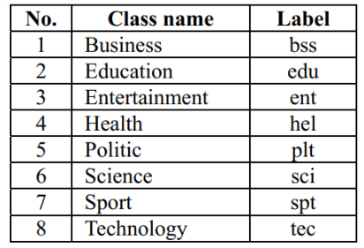




Class tree for text classification
For both Vietnamese and English training data.

Slide 15
Feature Selection
Predicate
công_nghệ
công_nghệ
Class
tec
edu
Feature
công_nghệ, tec
công_nghệ, edu
Predicates come from N-gram of syllables or words
Features over predicates is approximate 5/3

Slide 16
Classification Procedures
N-gram
Testing
Training
TXT
Predicates
Feature
F1-Measure
Maximum
Entropy
Context
Predicate + Class

Slide 17
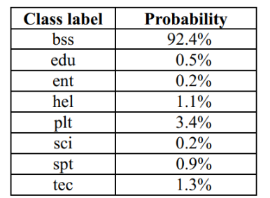
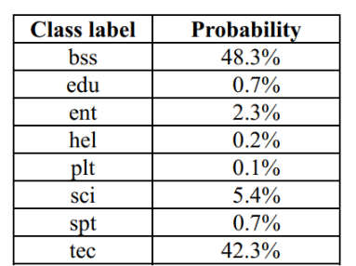
Examples of probability distribution
Business
Business & Tech ?

Slide 18
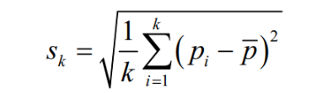
Dynamic threshold
First
Choose pm which is the highest probability value
Threshold value is flexible and is different for each situation.
Calculate standard deviation
Second
Last
Choose pj > pm – Sk
The corresponding class will be chosen

Slide 19
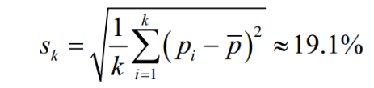
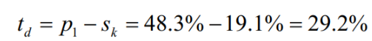
Firstly, we choose p1= 48.3%
Dynamic threshold td is :
Business & Tech !

Slide 20
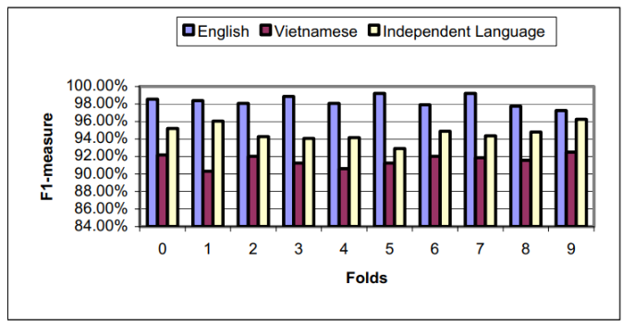
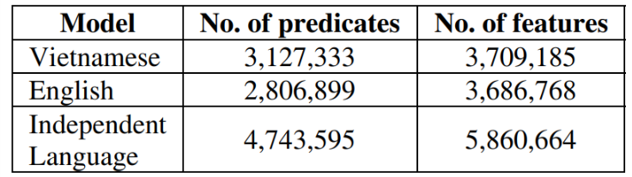
Results
F1 - Measure
No. of Predicates & Features
The ambiguity between English and Vietnamese is very low although both languages are written in Latin characters.

Slide 21
That’s all. Thank you! ☺
Any Questions?

